Slide 1
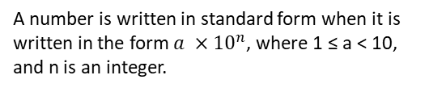





Subtopic N2.16 - Add and Subtract Numbers given in Standard Form
LEARNING OUTCOME: To understand how to add and subtract numbers using standard form.
Objectives:
Keywords:
Subtract
Add
Powers
To use different methods for adding and subtracting in standard form
To apply those skills to solve problems
Introduction – Read and annotate:
In this topic, you will learn how to add and subtract numbers written in standard form by using your
understanding of how to convert between standard form and ordinary (decimal) form. Since addition
and subtraction require numbers to be in the same power of ten, you will often need to rewrite one
or both numbers before calculating.
Characteristics
Definition
Standard form is a system for writing numbers.
It makes it easier to do calculations with very large or very small numbers.
Examples
Standard Form
Non - Examples
Adding numbers written in standard form (large numbers)
For the following questions, work out the answer and write your answer in standard form
Steps
1) Write the numbers as ordinary numbers | 6000 + 3000 9000 9 x 10³ | 6300 + 325000 331300 3.313 x 10⁵ | 4300 + 2000 6300 6.3 x 10³
2) Add the numbers using column addition
3) Change back to standard form
Example 1 - I do…
Example 2 – We do…
Example 3 – You do…
Independent Practice
1. For the following questions, work out the answer and put your answer in standard form:

Slide 2



Adding numbers written in standard form (small numbers)
For the following questions, work out the answer and write your answer in standard form:
Steps
1) Write the numbers as ordinary numbers | 0.0009 + 0.0002 0.0011 1.1 x 10⁻³ | 0.00023 + 0.000022 0.000252 2.52 x 10⁻⁴ | 0.0031 + 0.000065 0.003165 3.165 x 10⁻³
2) Add the numbers using column addition
3) Change back to standard form
Example 4 - I do…
Example 5 – We do…
Example 6 – You do…

Slide 3



Independent Practice
2. For the following questions, work out the answer and put your answer in standard form:
Subtracting numbers written in standard form (large numbers)
For the following questions, work out the answer and write your answer in standard form:
Steps
1) Write the numbers as ordinary numbers | 47000 - 3000 44000 4.4 x 10⁴ | 690000 - 1700 688300 6.883 x 10⁵ | 8300 - 3100 5200 5.2 x 10³
2) Subtract the numbers using column subtraction
3) Change back to standard form
Example 9 – You do…
Example 7 - I do…
Example 8 – We do…

Slide 4
Independent Practice
3. For the following questions, work out the answer and put your answer in standard form:

Slide 5



Subtracting numbers written in standard form (small numbers)
For the following questions, use the column method to work out the subtraction problems:
Steps
1) Write the numbers as ordinary numbers | 0.047 – 0.003 0.044 4.4 x 10⁻² | 0.000069 – 0.00000172 0.00006728 6.728 x 10⁻⁵ | 0.0083 – 0.0031 0.0052 5.2 x 10⁻³
2) Subtract the numbers using column subtraction
3) Change back to standard form
Example 10 - I do…
Example 11 – We do…
Example 12 – You do…
1 × 20 = 20 | so 1 and 20 are both factors of 20
2 × 10 = 20 | so 2 and 10 are both factors of 20
4 × 5 = 20 | so 4 and 5 are both factors of 20
Independent Practice
4. For the following questions, work out the answer and put your answer in standard form:

Slide 6



Adding and subtracting numbers written in standard form: getting the powers the same (large numbers)
For the following questions, work out the answer and write your answer in standard form
Steps |  | 1.2 x 10⁴ + 3.4 x 10⁴ | 5.6 x 10⁷ + 3.3 x 10⁷
1) If the powers are different, convert the numbers to the higher power | 6 + 3 9 9 x 10³ | 1.2 + 3.4 4.6 4.6 x 10⁴ | 5.6 + 3.3 8.9 8.9 x 10⁷
2) Add the base numbers using column addition
Example 13 - I do…
Example 14 – We do…
Example 15 – You do…
Steps |  |  | 7.2 x 10³ + 6.4 x 10⁴
1) If the powers are different, convert the numbers to the higher power | 0.43 x 10³ 0.43 + 2 2.43 x 10³ | 0.063 x 10⁵ 0.063 + 3.25 3.313 x 10⁵ | 0.72 x 10⁴ 0.72 + 6.4 7.12 x 10⁴
2) Add the base numbers using column addition
Example 16 - I do…
Example 17 – We do…
Example 18 – You do…
Steps
1) If the powers are different, convert the numbers to the higher power | 8 - 3 5 5 x 10⁵ | 0.031 x 10⁷ 5.8 – 0.031 5.769 x 10⁷ | 0.22 x 10⁶ 4.9 - 0.22 4.68 x 10⁶
2) Subtract the base numbers using column subtraction
Example 19 - I do…
Example 20 – We do…
Example 21 – You do…
‹#›

Slide 7
Independent Practice
5. For the following questions, work out the answer and put your answer in standard form:

Slide 8
Adding & Subtracting Standard Form – Getting the powers the same (small numbers)
Steps | 6.4 x 10⁻³ + 3.1 x 10⁻³ |  | 4.3 x 10⁻⁵ + 6.9 x 10⁻⁵
1) If the powers are different, convert the numbers to the higher power | 6.4 + 3.1 9.5 9.5 x 10⁻³ | 9 + 2 11 11 x 10⁻⁴ 1.1 x 10⁻³ | 4.3 + 6.9 11.2 11.2 x 10⁻⁵ 1.12 x 10⁻⁴
2) Add the base numbers using column addition
For the following questions, work out the answer and write your answer in standard form
Example 22 - I do…
Example 23 – We do…
Example 24 – You do…
Steps |  |  | 4.3 x 10⁻⁵ + 6.9 x 10⁻⁴
1) If the powers are different, convert the numbers to the higher power | 0.22 x 10⁻⁴ 2.3 + 0.22 2.52 x 10⁻⁴ | 0.065 x 10⁻³ 3.1 + 0.065 3.165 x 10⁻³ | 0.43 x 10⁻⁴ 0.43 + 6.9 7.33 x 10⁻⁴
2) Add the base numbers using column addition
Example 26 – We do…
Example 25 - I do…
Example 27 – You do…
Steps
1) If the powers are different, convert the numbers to the higher power | 8.3 – 3.1 5.2 5.2 x 10⁻³ | 0.3 x 10⁻² 4.7 – 0.3 4.4 4.4 x 10⁻² | 0.172 x 10⁻⁶ 6.9 – 0.172 6.728 6.728 x 10⁻⁵
2) Subtract the base numbers using column subtraction
Example 28 - I do…
Example 29 – We do…
Example 30 – You do…

Slide 9
Independent Practice
6. For the following questions, work out the answer and put your answer in standard form:

Slide 10
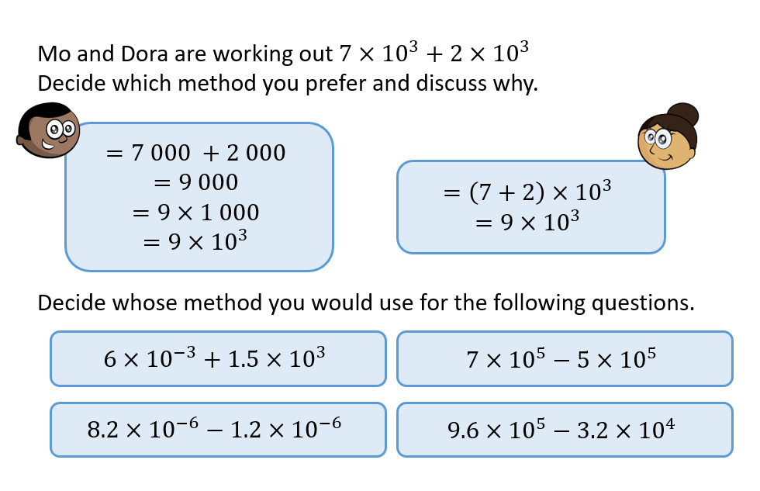
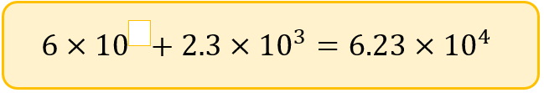
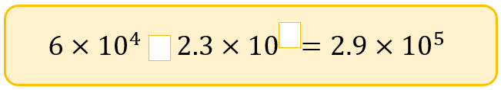
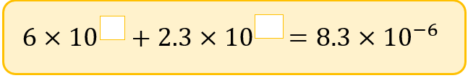

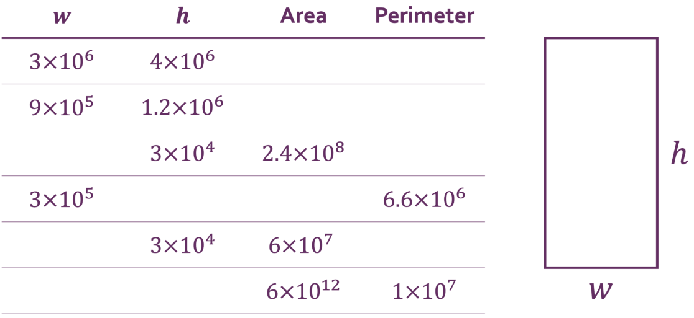
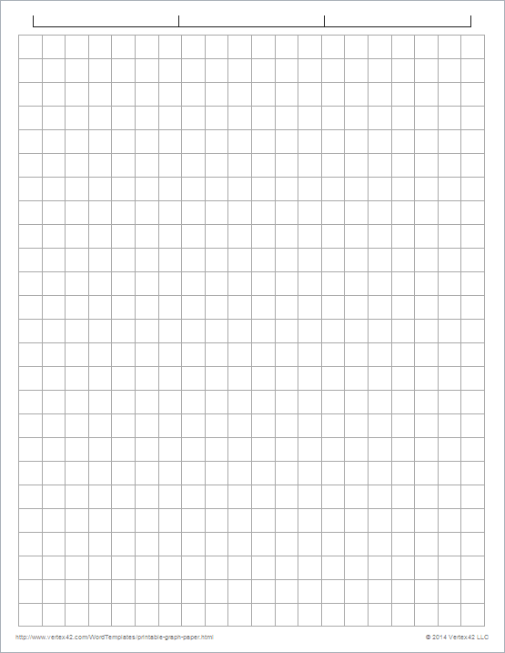
7.
Most efficient to use Mo’s method. | Most efficient to use Dora’s method.
Most efficient to use Dora’s method. | Either method equally as efficient.
8. Fill in the blanks.
4
+ 5
-6 -6
9. Fill in the blanks, giving all answers in standard form.
1.4 x 10⁷
4.2 x 10⁶
8 x 10³
7.6 x 10⁴
8 x 10³
3 x 10⁴
6.4 x 10⁴
2 x 10³
6.4 x 10⁴
2 x 10⁶
3 x 10⁶
2 x 10⁶
‹#›

Slide 11
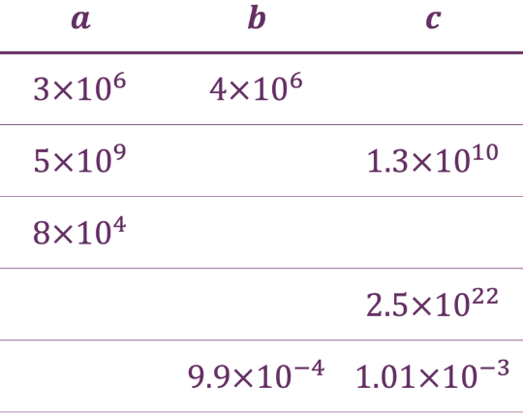
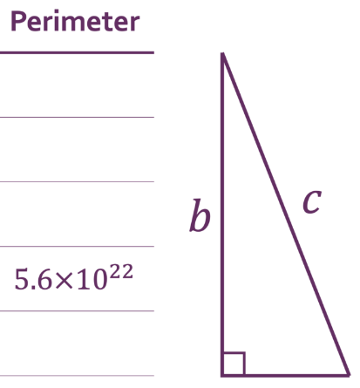



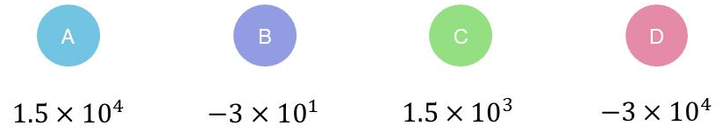
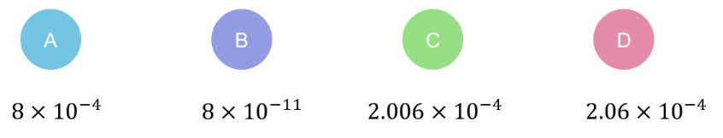
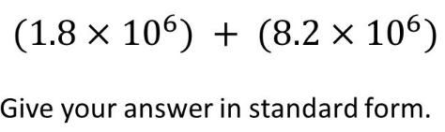
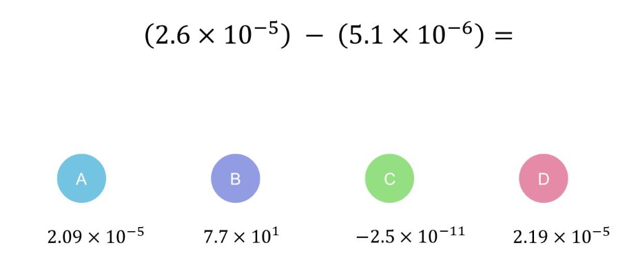
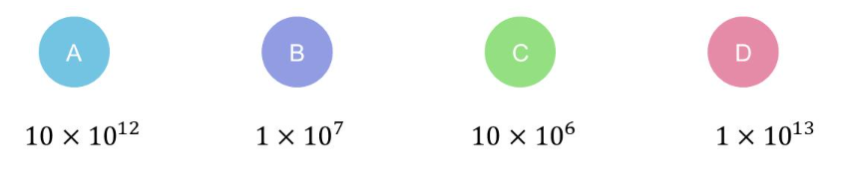
10. Fill in the blanks, giving all answers in standard form.
5 x 10⁶
5 x 10⁶
1.2 x 10⁷
1.2 x 10¹⁰
3 x 10¹⁰
1.2 x 10¹⁰
1.7 x 10⁵
4 x 10⁵
1.5 x 10⁵
1.7 x 10⁵
4 x 10⁵
7 x 10²¹
2.4 x 10²²
7 x 10²¹
2 x 10⁻⁴
2.2 x 10⁻³
2.2 x 10⁻³
Skills Check
1. Calculate: | 2. Calculate:
3. Calculate: | 4. Calculate:
‹#›

